Slide 1


Mohamad Shwaike
1.Jan.2023

Slide 2

Outline
Executive Summary
Introduction
Methodology
Results
Conclusion
Appendix

Slide 3
Executive Summary
Summary of methodologies:
This presentation will highlight on Data Collection with API and WebScraping and Data Wrangling additional to the Exploratory Data Analysis with SQL and Pandas. Then, how visualizae Exploratory Data Analysis using Matplotlib and using Interactive Visual Analytics and Dashboard. And also predictive Analysis with Machine Learning.
Summary of all results
Exploratory Data Analysis results
Predictive Analysis results

Slide 4
Introduction
Background:
In this capstone, we will predict if the Falcon 9 first stage will land successfully. SpaceX advertises Falcon 9 rocket launches on its website with a cost of 62 million dollars; other providers cost upward of 165 million dollars each, much of the savings is because SpaceX can reuse the first stage. Therefore if we can determine if the first stage will land, we can determine the cost of a launch. This information can be used if an alternate company wants to bid against SpaceX for a rocket launch.
Problem to Solve:
In this project , our objective is to train machine learning models with publicly available data to predict successful Stage 1 recovery

Slide 5

Section 1

Slide 6
Methodology
The overall methodology includes:
Data collection methodology:
Combined data from SpaceX public API and SpaceX Wikipedia page
Perform data wrangling
Classifying true landings as successful and unsuccessful otherwise
Perform exploratory data analysis (EDA) using visualization and SQL
Perform interactive visual analytics using Folium and Plotly Dash
Perform predictive analysis using classification models
Tuned models using GridSearchCV

Slide 7
Data Collection
Data collection process involved a combination of API requests from Space X public API and web scraping data from a table in Space X’s Wikipedia entry.
Using the SpaceX API , information was collected as JSON response which later on has been decoded into a Pandas DataFrame.
Data collection process involved a combination of API requests from Space X public API and web scraping data from a table in Space X’s Wikipedia entry.
The next slide will show the flowchart of data collection from API and the one after will show the flowchart of data collection from webscraping.

Slide 8
Data Collection – SpaceX API
Request SpaceX APIs
+JSON file (decode the response content)
Turn JOON to DataFrame
Filter the data to only include Falcon 9 launch
Dictionary relevant data
Cast dictionary to dataframe
Convert data into a CSV dataset
Replace the null values with the mean value
Make a request to SpaceX API and make sure the data is in the correct format.
Perform some basic data wrangling and formatting in order to clean the requested data.
Convert our data frame into a CSV dataset.
https://github.com/waelshouayki/DataScienceCapstone/blob/master/jupyter-labs-spacex-data-collection-api.ipynb.ipynb

Slide 9
Data Collection - Scraping
Request Wikipediahtml
Create a BeautifulSoup object from the HTML respone
Find launch info html table
Create an empty dictionary with keys from the extracted column names
Iterate through table cells to extract data to dictionary
Convert the dictionary into a CSV dataset
Using BeautifulSoup, perform web scraping on the wikipedia page with title: List of Falcon 9 and Falcon Heavy launches
Store the launch records in an HTML table.
Parse the table and convert it into a CSV dataset Present your web scraping process using key phrases and flowcharts
https://github.com/waelshouayki/DataScienceCapstone/blob/master/jupyter-labs-webscraping.ipynb

Slide 10
Data Wrangling
The goal in this stage is to find patterns in the data and determine the label for training supervised machine learning models.
Create a training label with landing outcomes where successful = 1 & failure = 0.
https://github.com/waelshouayki/DataScienceCapstone/blob/master/labs-jupyter-spacex-Datawrangling.ipynb
Determine the number of launches on each facility
Calculate the number and occurrences of each orbit
Calculate the number and occurrences of mission outcome per orbit type
Create a "Class" column containing the information from the outcome label
Transform the data frame into a CSV dataset.
Create a landing outcome training label and loop through all the landing outcomes

Slide 11
EDA with Data Visualization
Data visualization helps us understand data by curating it into a form that’s easier to understand, highlighting the trends and outliers. Several types of charts were used in the visualization of the data:
A bar chart was used to visualize the success rate of each orbit type.
A plot chart was used to visualize the relationship between FlightNumber and Orbit type
A line chart was used to visualize the launch success yearly trend https://github.com/waelshouayki/DataScienceCapstone/blob/master/jupyter-labs-eda-dataviz.ipynb

Slide 12
EDA with SQL
Loaded data set into IBM DB2 Database.
Queried using SQL Python integration.
Queries were made to get a better understanding of the dataset.
Queried information about launch site names, mission outcomes, various pay load sizes of customers and booster versions, and landing outcomes

Slide 13
Build an Interactive Map with Folium
Folium Markers were used to show the SpaceX launch sites and their nearest important landmarks like railways, highways, cities and coastlines.
Polylines were used to connect the launch sites to their nearest land marks.
Furthermore, Folium Circles were used to highlight circle area of launch sites.
In order to mark the success/failed launches for each site, marker clusters were used on the map. Whereby Red represents rocket launch failures while Green represents the successes.
https://github.com/waelshouayki/DataScienceCapstone/blob/master/launch_site_location_with_Folium.ipynb

Slide 14
Build a Dashboard with Plotly Dash
Dashboard includes a pie chart and a scatter plot.
Pie chart can be selected to show distribution of successful landings across all launch sites and can be selected to show individual launch site success rates.
Scatter plot takes two inputs: All sites or individual site and payload mass on a slider between 0 and 10000 kg.
The pie chart is used to visualize launch site success rate.
The scatter plot can help us see how success varies across launch sites, payload mass, and
booster version category.
https://github.com/waelshouayki/DataScienceCapstone/blob/master/spacex_dash_app.py

Slide 15
Predictive Analysis (Classification)
Create a column for the class
Standardize the data
Split data into training data and test data
Create a GridSearchCV object and fit different ML objects.
Calculate the accuracy on the test data
Choose the best ML method
Compare the predictions with the real labels
https://github.com/waelshouayki/DataScienceCapstone/blob/master/Machine_Learning_Prediction.ipynb

Slide 16
Results
The exploratory data analysis has shown us that successful landing outcomes are somewhat correlated with flight number. It was also apparent that successful landing outcomes have had a significant increase since the year 2015.
All launch sites are located near the coast line. Perhaps, this makes it easier to test rocket landings in the water.
Furthermore, the sites are also located near highways and railways. This may facilitate transportation of equipment and research material.
The machine learning models that were built, were able to predict the landing success of rockets with an accuracy score of 83.33%. This accuracy can be increased in future projects with more data.

Slide 17

Section 2

Slide 18
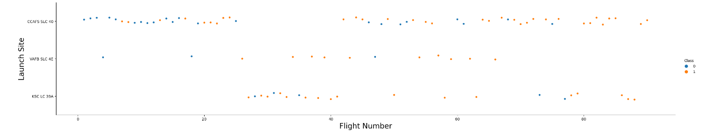
Flight Number vs. Launch Site
Green indicates successful launch; Purple indicates unsuccessful launch.
Graphic suggests an increase in success rate over time (indicated in Flight Number).
Likely a big breakthrough around flight 20 which significantly increased success rate.
CCAFS appears to be the main launch site as it has the most volume.

Slide 19
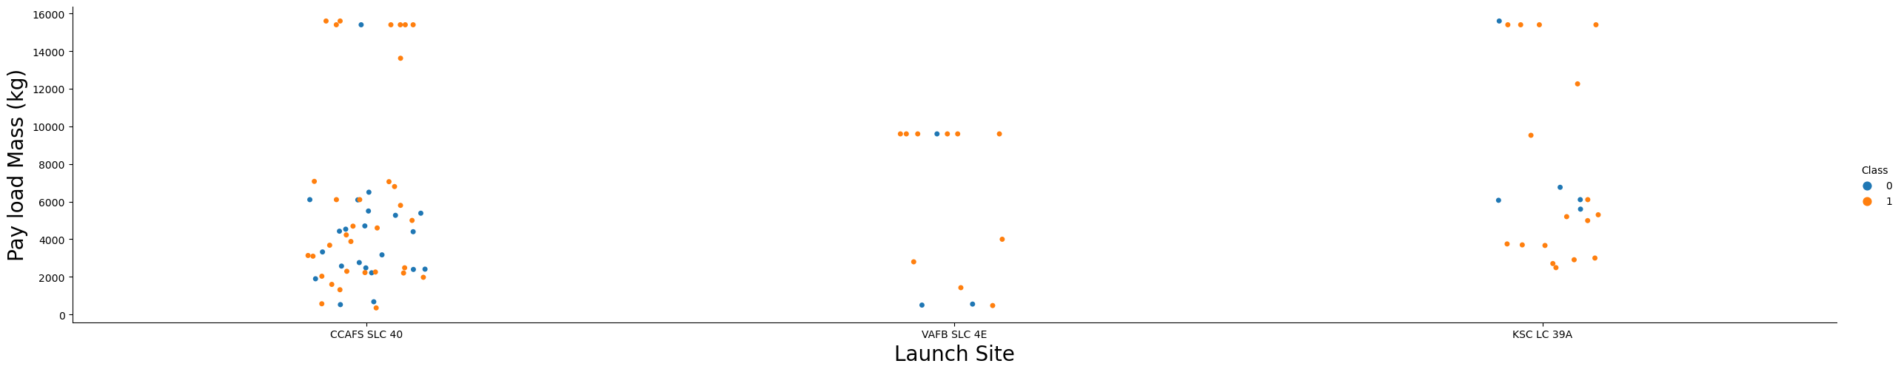
Payload vs. Launch Site
Green indicates successful launch; Purple indicates unsuccessful launch
No rocket launched with heavy payload mass in WAFB SLC

Slide 20
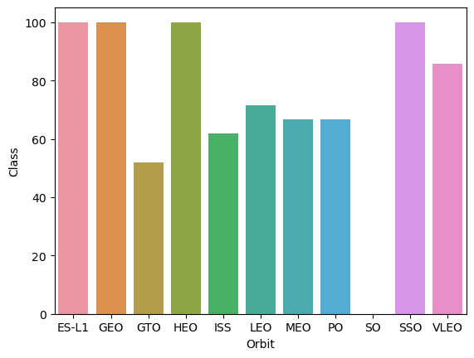
Success Rate vs. Orbit Type
ES-L1 , GEO , HEO, SSO have highest success rate (sample sizes in parenthesis)
SO has lowest success rate

Slide 21
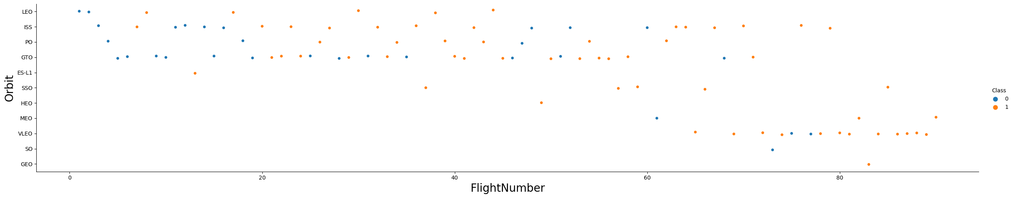
Flight Number vs. Orbit Type
Launch Orbit preferences changed over Flight Number. Launch Outcome seems to correlate with this preference.
SpaceX started with LEO orbits which saw moderate success LEO and returned to VLEO in recent launches SpaceX appears to perform better in lower orbits or Sun-synchronous orbits

Slide 22
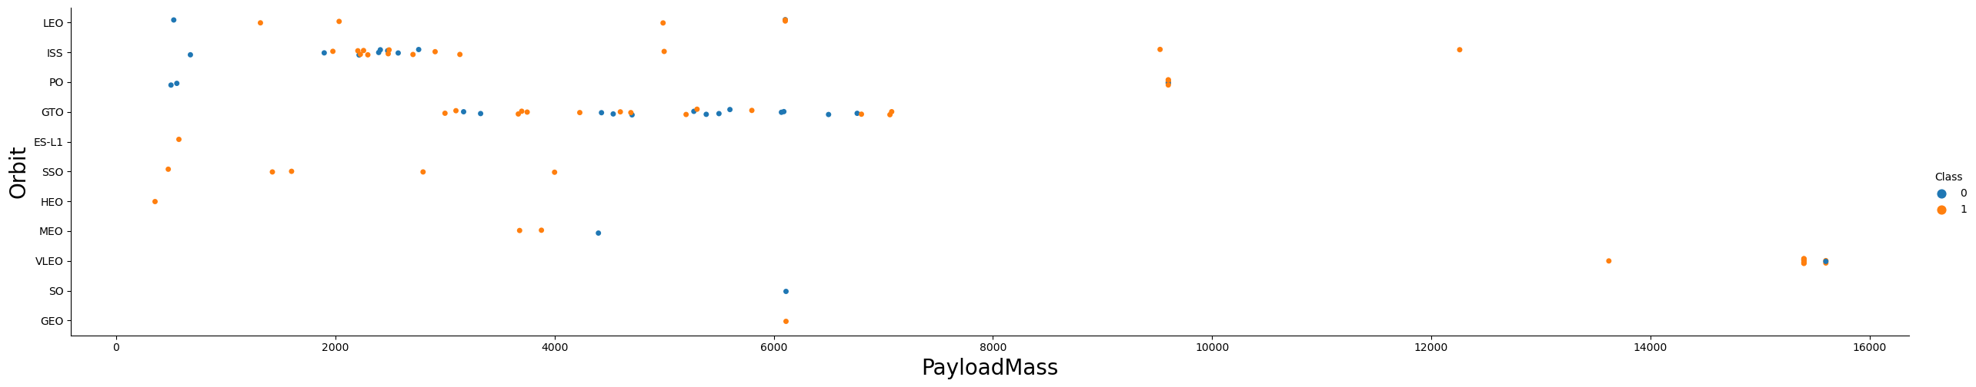
Payload vs. Orbit Type
With heavy payloads the successful landing or positive landing rate are more for Polar, LEO and ISS.
However for GTO we cannot distinguish this well as both positive landing rate and negative landing(unsuccessful mission) are both there.

Slide 23
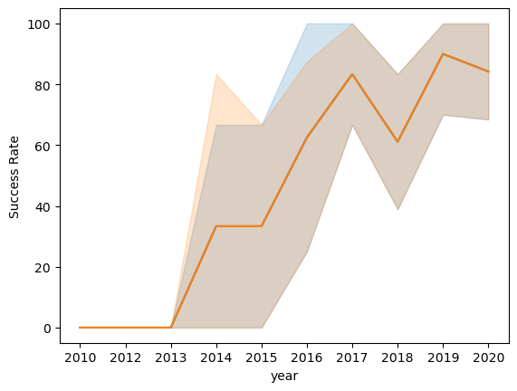
Launch Success Yearly Trend
Success generally increases over time since 2013 with a slight dip in 2018
Success in recent years at around 80%

Slide 24
All Launch Site Names
Given the data, these are the names of the launch sites where different rocket landings where attempted:
CCAFS LC-40
CCAFS SLC-40
KSC LC-39A
VAFB SLC-4E

Slide 25

Launch Site Names Begin with 'CCA'

Slide 26

Total Payload Mass

Slide 27

Average Payload Mass by F9 v1.1

Slide 28

First Successful Ground Landing Date

Slide 29

Successful Drone Ship Landing with Payload between 4000 and 6000

Slide 30

Total Number of Successful and Failure Mission Outcomes

Slide 31

Boosters Carried Maximum Payload

Slide 32

2015 Launch Records

Slide 33

Rank Landing Outcomes Between 2010-06-04 and 2017-03-20
Rank the count of landing outcomes (such as Failure (drone ship) or Success (ground pad)) between the date 2010-06-04 and 2017-03-20, in descending order

Slide 34

Section 3

Slide 35
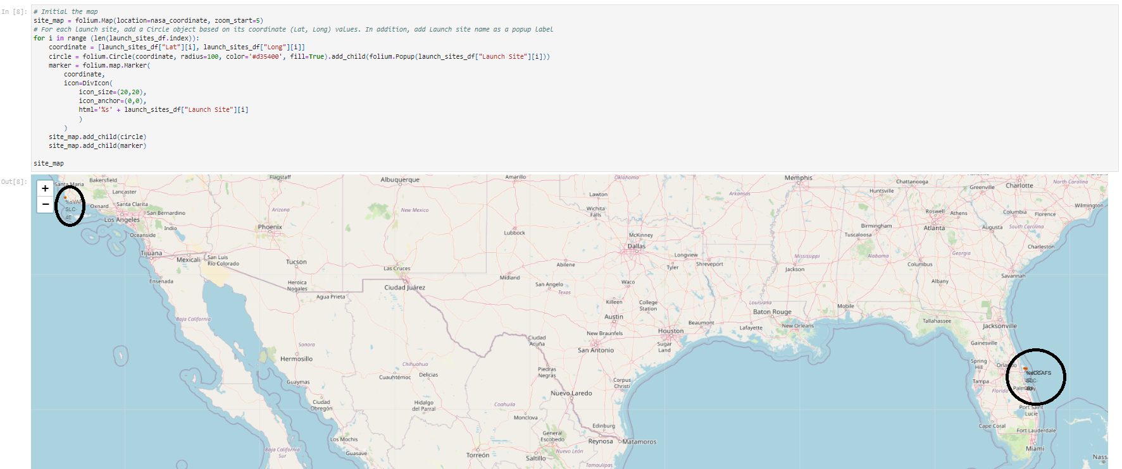
Launch Site Locations
We can see that all launch sites are in very close proximity to the coast and they are also a couple thousand kilometers away from the equator line.
It is interesting to see that most launch sites are concentrated near Miami.

Slide 36
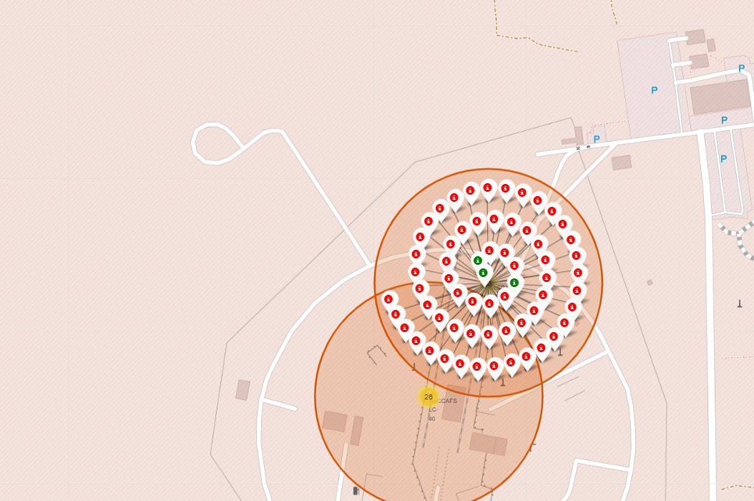
Successful Rocket Launches
The successful launches are represented by a green marker while the red marker represents failed rocket launches.

Slide 37
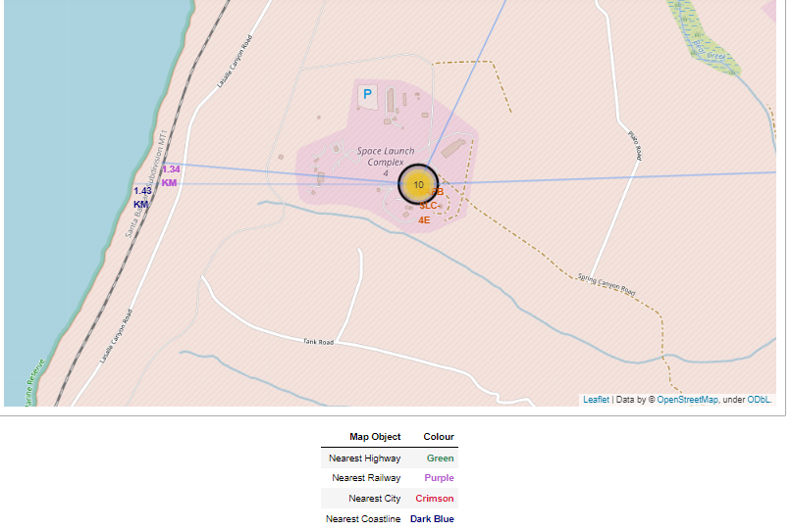
Surrounding Landmarks
It appears that launch sites are usually set up at least 18 km away from cities. This may be because of the desire to prevent any crashes near populated areas.
It is also apparent that launch sites are in very close proximity to railways and highways. Perhaps, due to the necessary transportation requirements for rocket parts

Slide 38

Section 4

Slide 39
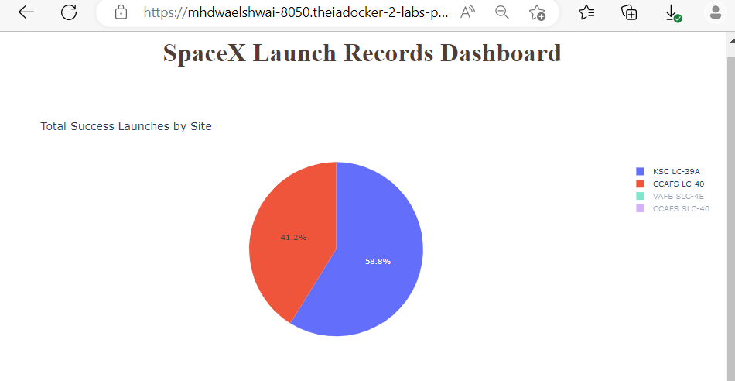
Successful Launches ite
Site KSC LC-39A has the largest successful launches as well the highest launch success rate.
More investigation may be needed to determine why KSC LC-39A is the preferred launch site.

Slide 40
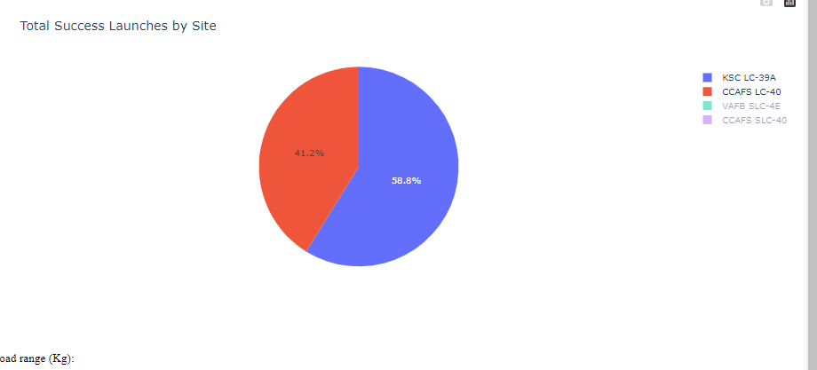
Total Successful Launches for Site KSC LC-39A
As we can see, 76.9% of the total launches at site KSC LC-39A were successful. This is a the highest success rate of all the different launch sites.
However, this success rate was only around 3% higher than the runner up; site CCAFS LC-40.

Slide 41
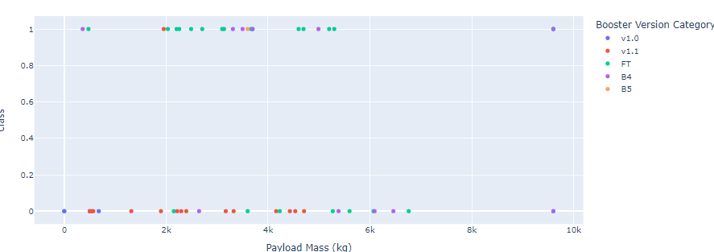
Launch Success and Payload Mass for All Sites
highest success rate is for payload between 2000 kg and 4000 kg

Slide 42

Section 5

Slide 43
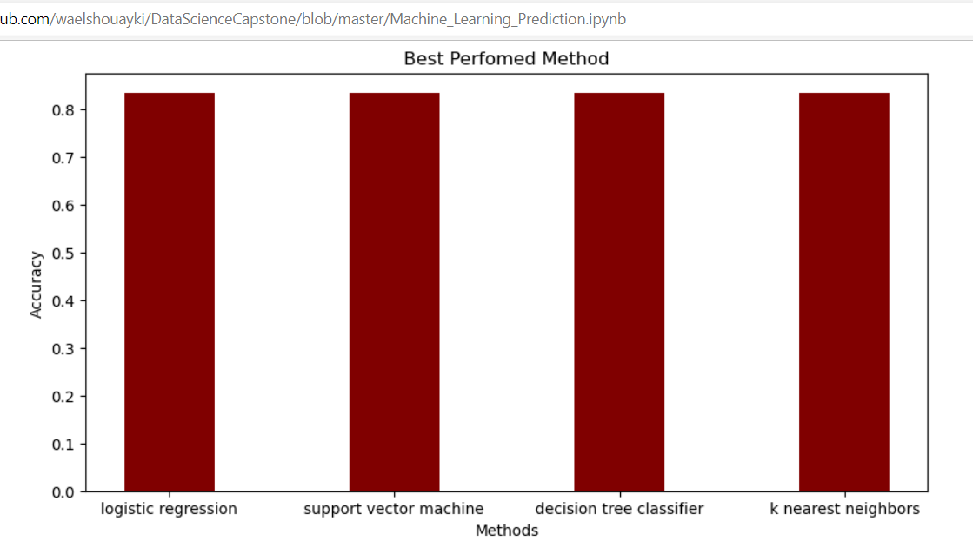
Classification Accuracy
All method having same accuracy, so logistic regression is required for the classification

Slide 44
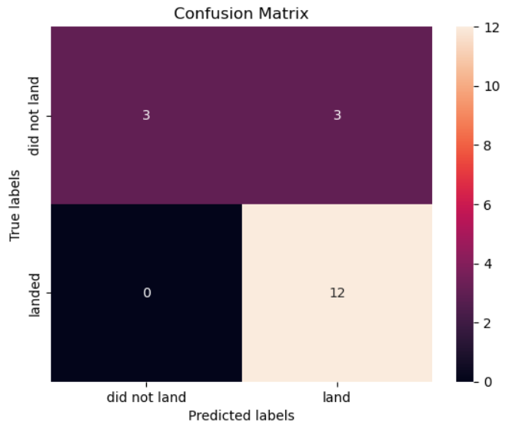
Confusion Matrix
The model only failed to accurately predict 3 labels.

Slide 45
Conclusions
Develop a machine learning model for Space Y who wants to bid against SpaceX
The goal of model is to predict when Stage 1 will successfully land to save ~$100 million USD
Use data from a public SpaceX API and web scraping SpaceX Wikipedia page
Create a dashboard for visualization
Create a machine learning model with an accuracy of 83%

Slide 46


